Slide 1
Goga, Samiran, Stefan & Lukas
Notes:
luki

Slide 2
Project converzone.
What is converzone?
A social network which let‘s you meet people with similar interests around the world to learn languages or gives you the chance to make friends from all over the world.
Future plans
Adding categories
Expand on other platforms
Notes:
luki

Slide 3
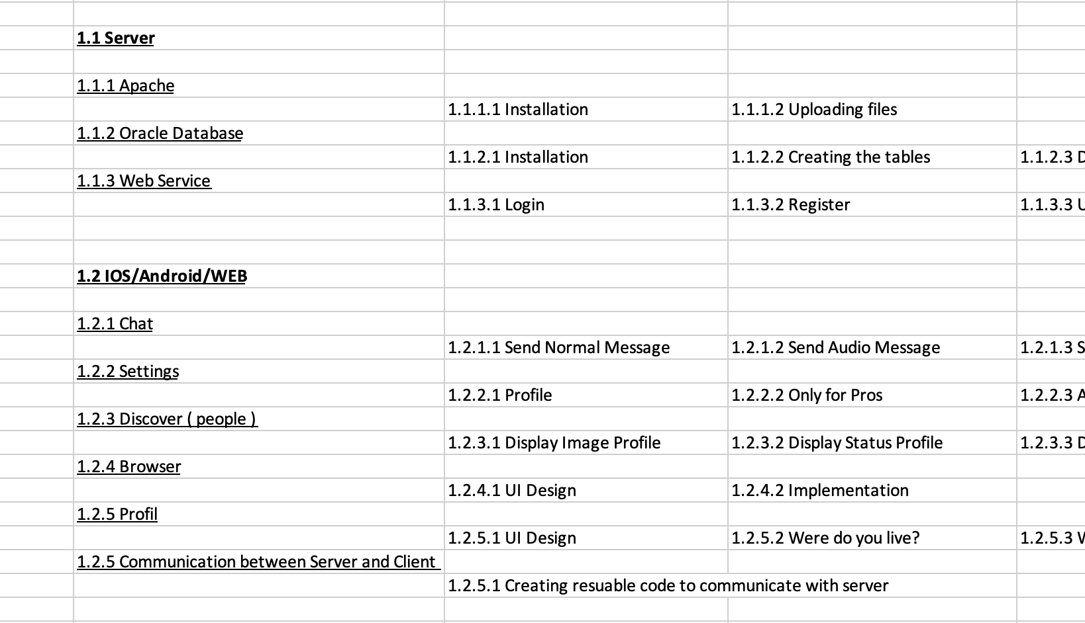
Scope of the project.
Server
Apache
Oracle Database
Web Services
Client
Chat
Discover
Browser
Notes:
gogi

Slide 4
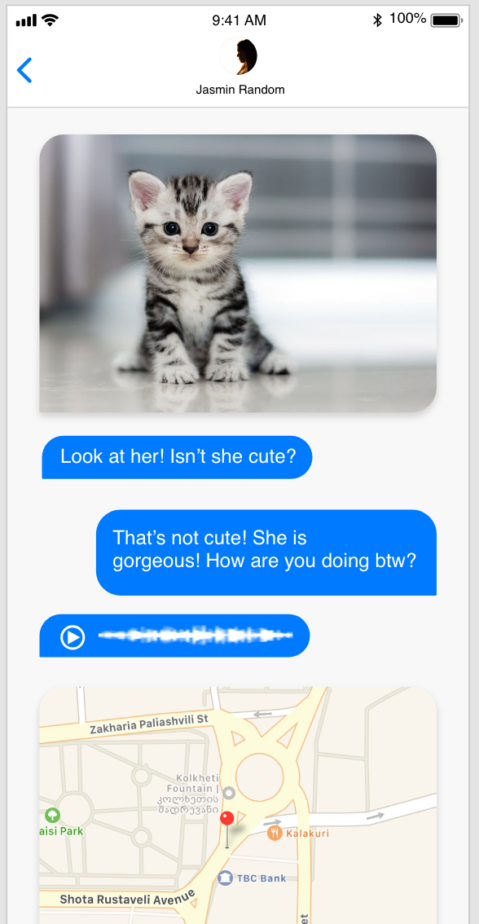
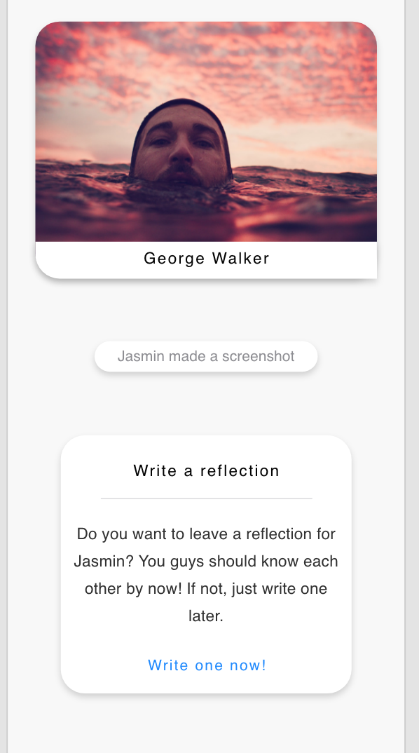
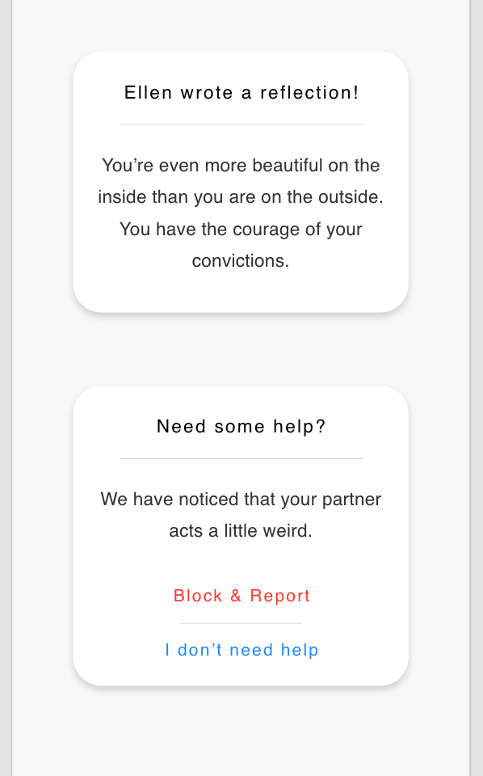
Chat iOS.
Notes:
gogi

Slide 5
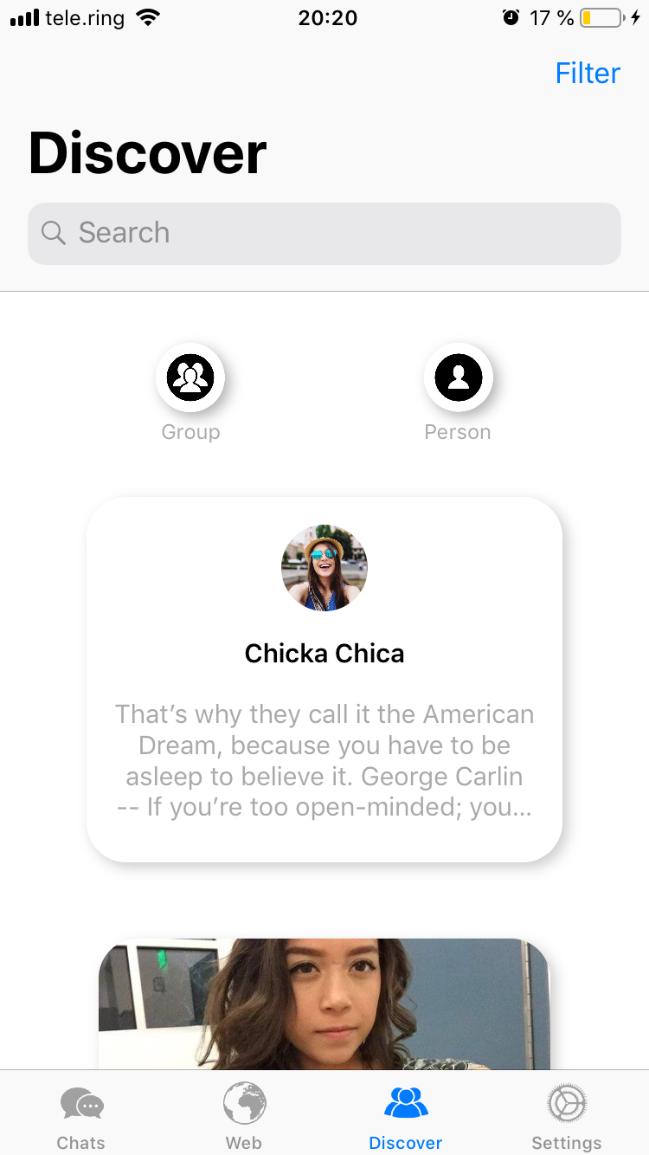
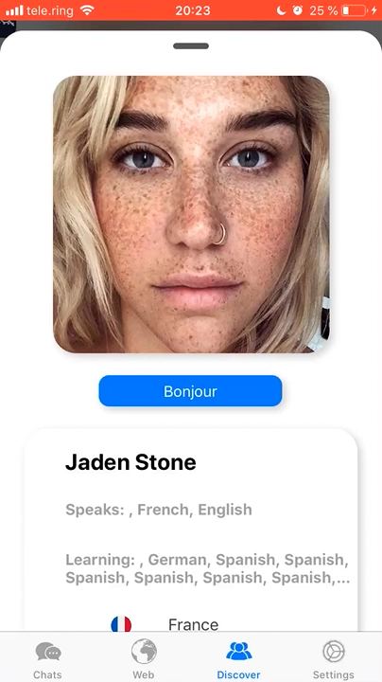
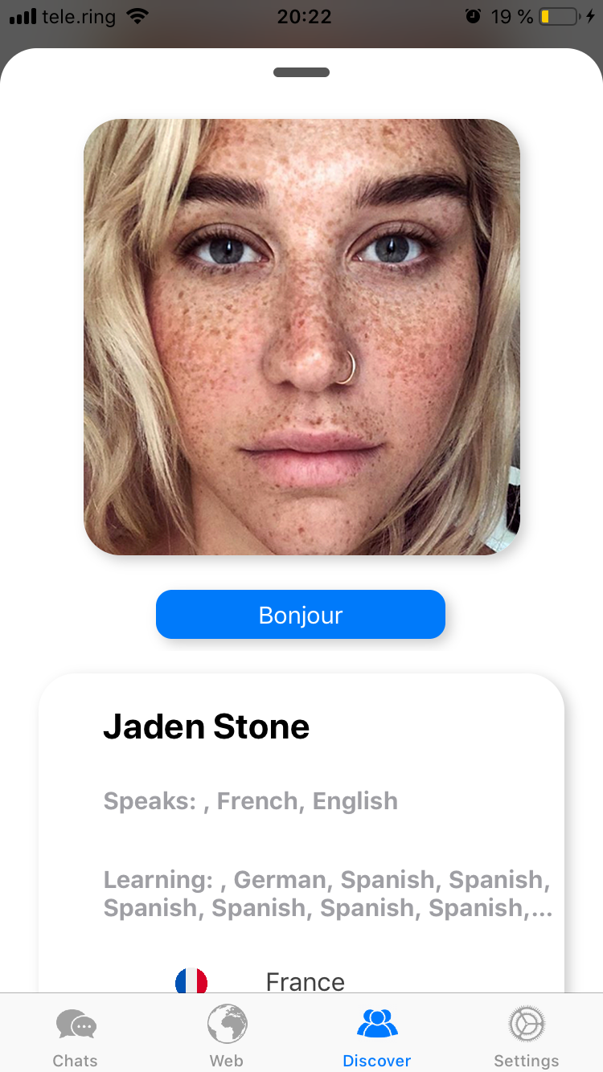
Discover iOS.
Notes:
gogi

Slide 6
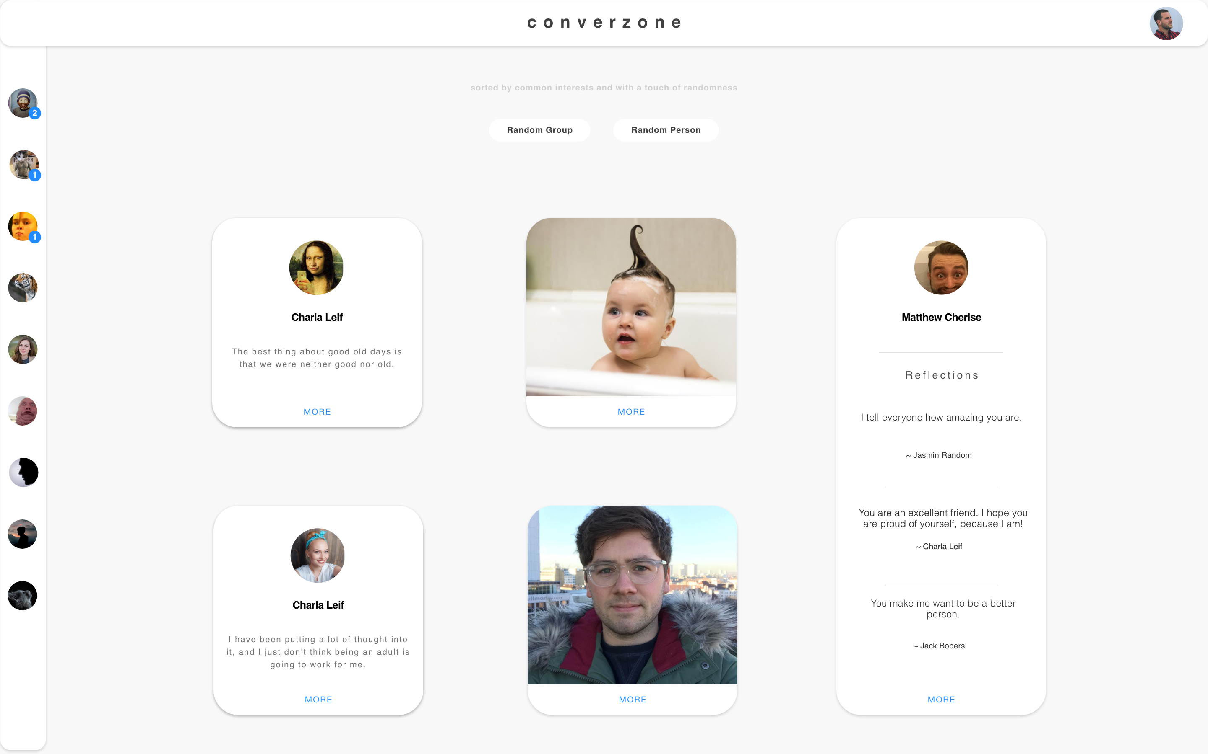
Discover Web.
Notes:
sami

Slide 7
Technologies.

Slide 8
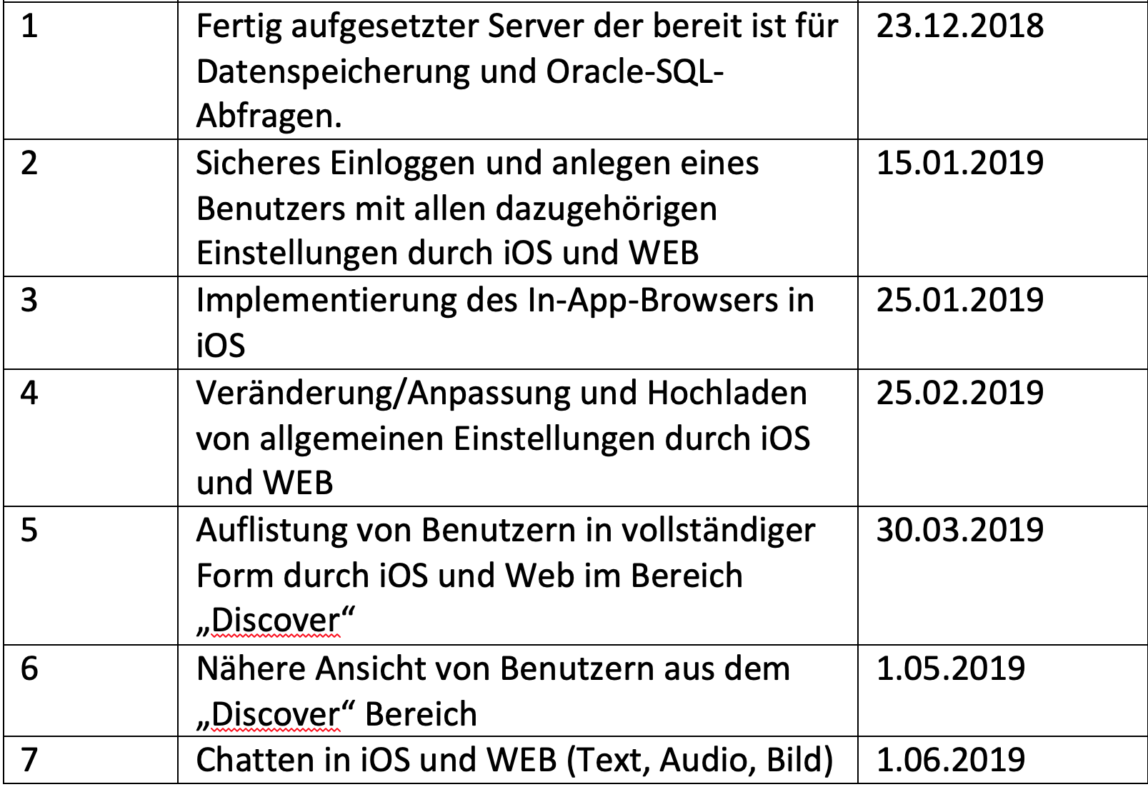
Milestones
Notes:
stefi

Slide 9
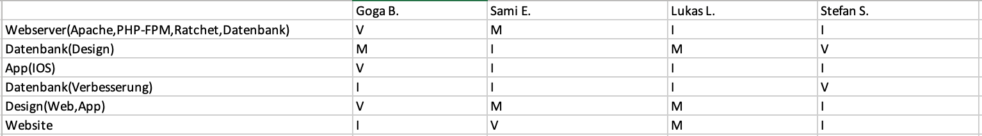
IMV-Matrix
Notes:
sami

Slide 10
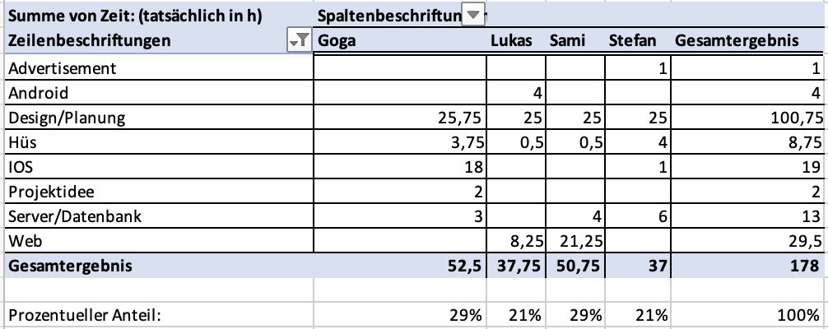
Time records.
Notes:
stefi

Slide 11
Thank you for your attenti-…

